Slide 1

Mastering Backend Development: A Deep Dive
Welcome! This presentation will guide you through the essential building blocks of backend development, encompassing REST APIs, testing frameworks, and the powerful GraphQL language. We'll explore concepts, best practices, and practical examples to enhance your understanding of this critical area of software development.
NH
by Nabeel Haider

Slide 2
Introduction to Backend Development
What is Backend?
Key Responsibilities
The backend is the hidden foundation of a website or application. It handles data storage, logic, and processing, ensuring seamless functionality on the front end. Think of it as the brain and heart of your digital creation, working tirelessly behind the scenes.
The backend is responsible for tasks like user authentication, data management, and processing complex operations. It also interacts with databases, handles API requests, and ensures secure communication between the frontend and the server.

Slide 3

Understanding REST APIs
1
Representational State Transfer (REST)
2
Core Concepts
REST APIs rely on standard HTTP methods (GET, POST, PUT, DELETE) to perform actions like retrieving, creating, updating, and deleting data. They follow a clear structure and use JSON as a common data format.
REST is an architectural style for building APIs. It uses a set of principles that define how clients and servers communicate, enabling data exchange across different platforms.
3
Benefits
REST APIs are known for their simplicity, scalability, and versatility. They are widely adopted in modern web development, facilitating seamless integration between applications and services.

Slide 4



Mocha: A Powerful Testing Framework
Robust Testing
1
Mocha is a JavaScript framework designed for comprehensive testing. It provides a flexible environment for creating various test scenarios, ensuring code quality and reliability.
Asynchronous Support
2
Mocha excels in handling asynchronous operations common in backend development. It allows you to test functions that interact with databases, APIs, and other services efficiently.
Rich Reporting
3
Mocha offers detailed reports that clearly highlight test results, making it easy to identify errors and troubleshoot issues. It also provides informative feedback on test coverage.

Slide 5
Exploring SOAP and its Advantages
Simple Object Access Protocol (SOAP)
1
SOAP is a protocol for exchanging structured information over networks. It uses XML-based messages to facilitate communication between applications, regardless of their underlying platforms or technologies.
Standardization
2
SOAP is known for its standardized structure, providing a consistent and predictable format for data exchange. This makes it suitable for scenarios where robust interoperability is essential.
Security Features
3
SOAP offers built-in security mechanisms, including encryption and authentication, ensuring data integrity and protecting sensitive information during transmission.

Slide 6




Jest and Chai: A Dynamic Testing Duo
Jest
Jest is a JavaScript testing framework developed by Facebook. It is widely used for unit testing, integration testing, and snapshot testing, ensuring the reliability and stability of your backend code.
Chai
Chai is a flexible assertion library for JavaScript. It offers a human-readable syntax and supports various testing styles, including TDD (Test-Driven Development) and BDD (Behavior-Driven Development).
Combined Power
Together, Jest and Chai provide a powerful testing ecosystem. They complement each other, offering a comprehensive set of tools for building robust and reliable backend applications.

Slide 7

GraphQL: The Modern Data Query Language
Flexible Queries
Evolutionary
GraphQL allows clients to request precisely the data they need, minimizing unnecessary data transfer and improving performance. It provides a powerful and efficient way to interact with databases.
GraphQL is a rapidly evolving technology that is continually being improved. As new features and capabilities are added, it remains at the forefront of backend development, providing innovative solutions for data management.
1
2
3
Strong Typing
GraphQL enforces a strong type system, ensuring that data is consistent and predictable. This reduces errors and promotes code clarity, making it easier to manage complex data structures.

Slide 8
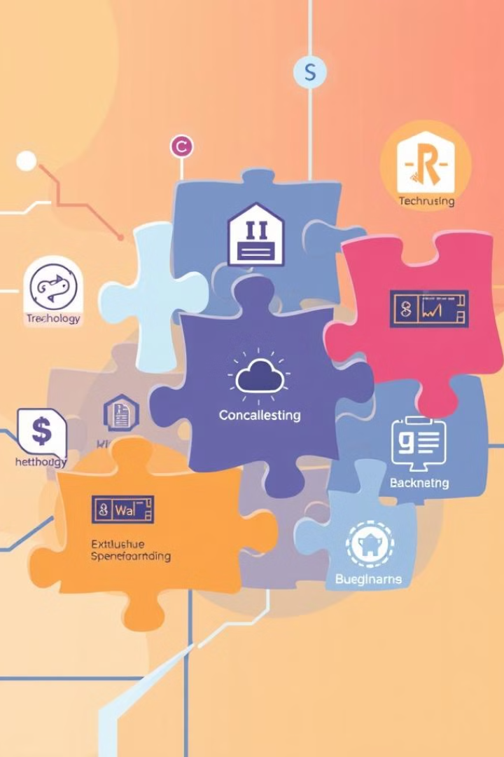



Integrating These Technologies
API Development
REST APIs serve as the foundation for communication between your application and external services. They provide a standardized way to exchange data, enabling smooth integration with other systems.
Testing
Testing frameworks like Mocha, Jest, and Chai play a crucial role in ensuring code quality. They help you identify bugs, validate functionality, and build confidence in your backend application.
Data Management
GraphQL provides a modern approach to data querying. Its flexible syntax and powerful features simplify complex data access, improving performance and developer productivity.

Slide 9

Conclusion and Key Takeaways
Mastering REST APIs, testing frameworks (Mocha, Jest, Chai), and GraphQL empowers you to build robust, efficient, and scalable applications. This journey has unveiled these technologies as essential pillars for exceptional software experiences, equipping you with the skills to create outstanding software.

